Slide 1
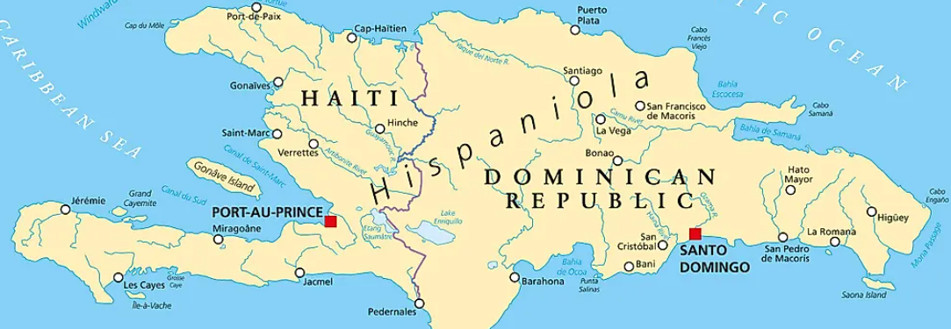
From La Sentencia to a Transnational Hispaniola
Presenters: Ana Belique,
Professor Jean Eddy Saint Paul, and Professor Amarilys Estrella
Curated By: Professor Albert Garcia

Slide 2
Title Defined
La Sentencia
In 2013 the Dominican Republic’s Constitutional Tribunal issued ruling 168-13, which retroactively revoked the Dominican citizenship of all persons born to Haitian parents since 1929. This ruling is commonly known as La Sentencia.
Transnational Hispaniola
Transnational Hispaniola formulates a new scholarly consensus on Haitian-Dominican relations, arguing against an earlier generations’ scholarship that utilized a fatal-conflict model and instead promotes research into the countless ties that bind the people on both sides of Hispaniola.

Slide 3
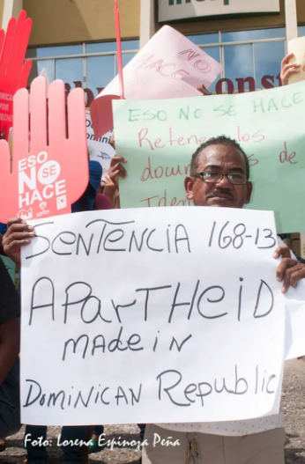
La Sentencia
In 2010, Dominican Republic adopted a new Constitution which cemented the right to citizenship through blood overwriting the right to citizenship through soil or being born in the territory. Under these conditions, Dominican citizens could only be children born of Dominican mothers and fathers, persons born on national territory, with the exception of children of foreign diplomats and foreigners who find themselves in transit or who reside illegally in DR.
La Sentencia in 2013, stated that Dominicans of Haitian descent are not Dominicans because they state that their Haitian parents were either undocumented or in-transit.

Slide 4
Dominican Ultranationalism
The foundation of Dominican ultranationalist ideology comes from the Dominican national identity created after the separation from Haiti in 1844.
It is based on a fear of “invasion” as well as a desire to maintain power over the Dominican people.

Slide 5
Transnational Hispaniola
Transnational Hispaniola is an approach that centers the ties that bind Hispaniola and its diaspora together. The shared sociocultural and political history make the identities intertwined therefore there is no Dominicaness without Haitianess and vice-versa.
Haitians and Dominicans of Haitian descent need to be recognized as Dominicans with all the rights of a first-class citizen because Dominicaness cannot be contained by an ideology afraid to admit its own blackness, or more specifically its Haitian reflection.

Slide 6
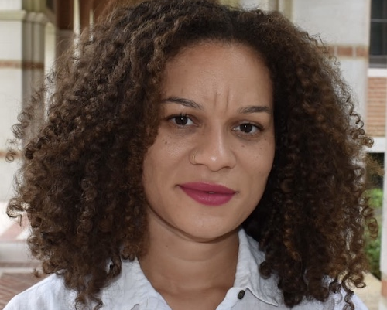
Presenters
Amarilys Estrella
Assistant Professor, Rice University
Discussion Topics: Stateless and Solidarity
Jean Eddy Saint Paul
Professor, Brooklyn College
Discussion Topics: Nation-State, Dominicanidad/Dominicanité, and Haitianidad/Haitianité
Ana Maria Belique
Founder and Leader, Reconoci.do
Discussion Topics: Reconocimiento (Recognition) and Resistencia (Resistance)

Slide 7
Citizens of Nowhere

Slide 8
What is the most interesting or useful thing you learned today? What will you do with it?
Padlet Link: https://padlet.com/agarcia3106/teach-in-from-la-sentencia-to-a-transnational-hispaniola-1g2kgjmn6xfk6pgm

Slide 9
Resources
Selected Bibliography
2018 Estrella, Amarilys and Saudi Garcia (We Are All Dominican Collective). Ni de aquí ni de allá: Denationalization and Mass Deportation between the United States and the Dominican Republic. Emisferica. Vol 14. Issue 1. 2018.
2018 Cruz, Kleaver, Amarilys Estrella and Yanilda Gonzalez. 2018. Aqui y Alla: The Diaspora Needs to Stand with Dominicans Challenging Anti-Blackness in the D.R.
2020 “Muertos Civiles: Mourning the Casualties of Racism in the Dominican Republic." Transforming Anthropology Vol. 28 No. 1 pp 41-57.
Abréu. (2014). Sin haitianidad no hay dominicanidad : cartografía de una identidad que se bifurca. Editora Nacional.
Hayes de Kalaf, E. (2022). Legal Identity, Race and Belonging in the Dominican Republic: From Citizen to Foreigner. Anthem Press. https://doi.org/10.2307/j.ctv22pzz22
Lara, A. M. (2017). A Smarting Wound: Afro-Dominicanidad and the Fight against Ultranationalism in the Dominican Republic. Feminist Studies, 43(2), 468–484. https://doi.org/10.1353/fem.2017.0015
Martínez, S. (2021). Transnational Hispaniola: New Directions in Haitian and Dominican Studies, by April J. Mayes & Kiran C. Jayaram (eds.), New West Indian Guide / Nieuwe West-Indische Gids, 95(3-4), 344-346. doi: https://doi.org/10.1163/22134360-09503030
Paulino, E. (2016). DOMINICAN REPUBLIC: Bearing Witness to a Modern Genocide | Center for Latin American Studies. Clas.berkeley.edu. https://clas.berkeley.edu/dominican-republic-bearing-witness-modern-genocide
Torres-Saillant. (2010). Introduction to Dominican Blackness. CUNY Academic Works.
Other Resources
We Are Who We Are – Book PDF
https://www.reconoci.do/libro-somos-quien-somos-whe-are-who-we-are/
Elena Lorac, Movimiento Reconoci.do - Video (Youtube)
Hasta La Raiz - Movie (Youtube)
Elena – Short Film (Youtube)
Essential Websites: Noscamb.io, wearealldominicannyc.wordpress.com, and reconoci.do
Instagram: @dominicanxs_ and @reconoci.do

